Slide 1

Redistricting 2015
November 5, 2015

Slide 2
recommendations
Committee & Superintendent
To provide immediate relief to the overcrowding at Albemarle High School:
A. Transfer the area of ‘Route 20 north of Proffit Road’ from Sutherland Middle School/ Albemarle High School to Burley Middle School/Monticello High School. As of September 9, the area had 70 AHS students and 47 Sutherland students.
B. Transfer of the area ‘Rio Road East of the railroad tracks and Rio Road East including Abbington and Pine Haven’ from Albemarle High School to Monticello High School: As of September 9, the area had 144 AHS students.
Continued…

Slide 3
recommendations
Committee & Superintendent
C. Grandfather Clause
  Option 1:
  All current (2015/16 school year) Albemarle & Sutherland students in affected neighborhoods shall be allowed to finish their years in the school they are currently enrolled. This grandfather clause should apply to all siblings of current (2015/16 school year) Albemarle High School & Sutherland students in affected neighborhoods as well. This only applies to siblings currently enrolled in ACPS.
  Option 2:
  All current Albemarle High and Sutherland Middle students shall be permitted to finish their years in the schools in which they are enrolled. Siblings of current Albemarle High students who are currently at Sutherland and Burley Middle Schools would be grandfathered for attendance at Albemarle High.
  In either option, transportation is not provided. by the school division to families who choose to grandfather. The choice to grandfather for the 2016/17 school year will need to be made no later than January 29th, 2016.

Slide 4
recommendations
Committee & Superintendent
To provide immediate relief to the overcrowding at Greer Elementary School:
Do not redistrict any area. Instead, direct to staff evaluate non-redistricting options that may include housing Greer 5th grade at Jouett Middle School, relocating Greer’s pre-k programs, utilizing mobile classrooms, or other creative solutions that would provide temporary relief until additional seats are built at Woodbrook. Any solution should be implemented for the 2016/17 school year.

Slide 5
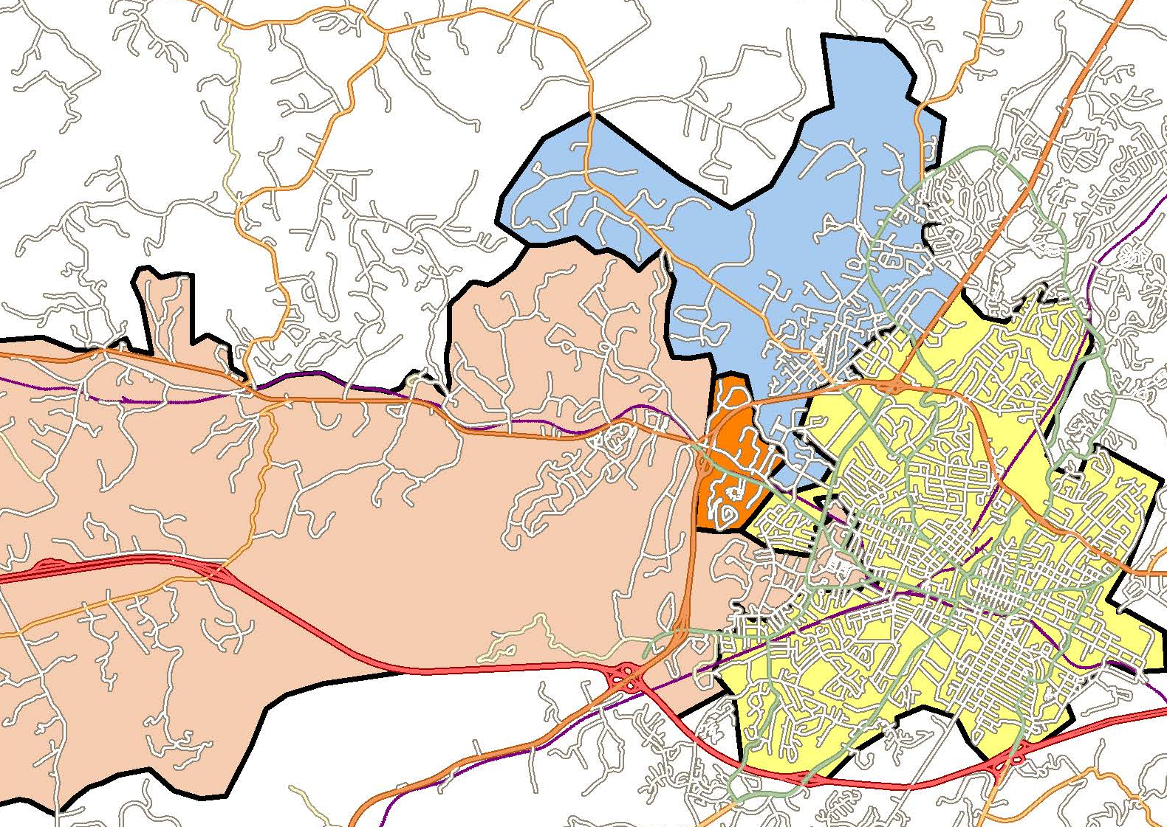
Greer option A2
GREER
Colonnades/Old Ivy
(64 Greer students)
MURRAY

Slide 6
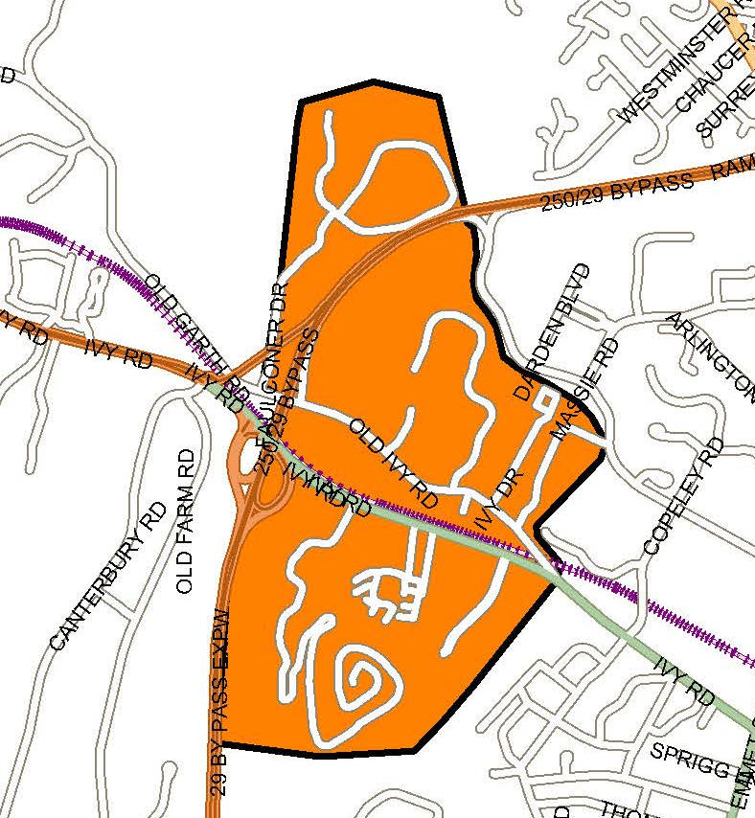
Greer option a2 (CONT.)
Colonnades/Old Ivy
Current
Greer: 64 students
Jouett: 18 students
Albemarle: 27 students
Proposed: Murray Elementary
Students would remain at Jouett/Albemarle
(previous iterations studied the transfer to Henley/Western or Burley/Monticello)

Slide 7
Greer option a2 (CONT.)
Colonnades/Old Ivy
Distance from the top of Colonnade Dr. to schools (miles)
Before | Greer
 | 4.3
After | Murray
 | 5.96
Distance from the top of Colonnade Dr. to schools (minutes)
Before | Greer
 | 14:29
After | Murray
 | 10:31

Slide 8
Greer option A2 (CONT.)
Colonnades/Old Ivy: Enrollment History
Level | 2010/11 | 2011/12 | 2012/13 | 2013/14 | 2014/15 | 2015/16
Elementary | 19 | 19 | 33 | 56 | 59 | 64
Middle | 4 | 7 | 13 | 30 | 26 | 18
High | 9 | 9 | 19 | 35 | 28 | 27

Slide 9
Greer option A2 (CONT.) Demographic impact

Slide 10
Greer option A2 (CONT.) Demographic impact

Slide 11
Greer option A2 (CONT.) enrollment v. capacity
Elementary School | Building Capacity | Current & Projected Seat Surplus/Deficiency
 |  | 9/1/15 | 2016/17 | 2017/18 | 2018/19 | 2019/20 | 2020/21
Greer | 578 | -33 | -69 | -80 | -103 | -93 | -81
Murray | 296 | 43 | 45 | 40 | 41 | 50 | 41
*Projections updated based on 9/1/15 enrollment data

Slide 12
Greer option A2 (CONT.) capacity utilization
1 year:
2016/17
5 year*:
2020/21
*Based on 5 year projections of school enrollment + the affected neighborhood’s current enrollment. It does not reflect any growth in the neighborhood enrollment as that information is not available.

Slide 13
Greer option A2
Enrollment by Grade Level
Greer
murray
Grade | Current | After | Difference
K | 119 | 104 | -15
1st | 114 | 104 | -10
2nd | 108 | 93 | -15
3rd | 78 | 70 | -8
4th | 82 | 73 | -9
5th | 58 | 51 | -7
Total | 559 | 495 | -64
Grade | Current | After | Difference
K | 46 | 61 | +15
1st | 33 | 43 | +10
2nd | 43 | 58 | +15
3rd | 46 | 54 | +8
4th | 37 | 46 | +9
5th | 44 | 51 | +7
Total | 249 | 313 | +64

Slide 14
Greer option A2
# of classes per grade
Greer
murray
Grade | Current | After | Difference
K | 7 | 6 | -1
1st | 7 | 7 | 0
2nd | 6 | 5 | -1
3rd | 5 | 4 | -1
4th | 4 | 4 | 0
5th | 4 | 3 | -1
Total | 33 | 29 | -4
Grade | Current | After | Difference
K | 2 | 3 | +1
1st | 2 | 2 | 0
2nd | 2 | 3 | +1
3rd | 2 | 3 | +1
4th | 2 | 2 | 0
5th | 2 | 2.5 | +.5
Total | 12 | +15.5 | +3.5
Additional classes would require the use of 2 trailers

Slide 16
Approved School Board CIP Request: FY17 – FY21
RANK | Project | FISCAL YEAR |  |  |  |  | 5 Year Total
 |  | 1 | 2 | 3 | 4 | 5
 |  | 16/17 | 17/18 | 18/19 | 19/20 | 20/21
1 | Maintenance/Replacement Program | $ 7,783,000 | $ 6,418,750 | $ 6,803,000 | $ 6,822,000 | $ 7,155,000 | $ 34,981,750
2 | State Technology Grant | $ 752,000 | $ 752,000 | $ 752,000 | $ 752,000 | $ 752,000 | $ 3,760,000
3 | Instructional Technology | $ 575,000 | $ 575,000 | $ 575,000 | $ 575,000 | $ 575,000 | $ 2,875,000
4 | Administrative Technology | $ 261,000 | $ 263,000 | $ 263,000 | $ 263,000 | $ 263,000 | $ 1,313,000
5 | Telecommunications Network Upgrade | $ 900,000 |  |  | $ 900,000 |  | $ 1,800,000
6 | School Bus Replacement | $ 1,200,000 | $ 1,200,000 | $ 1,200,000 | $ 1,200,000 | $ 1,200,000 | $ 6,000,000
7 | Security Improvements | $ 2,391,364 | $ 1,403,089 |  |  |  | $ 3,794,453
8 | Red Hill Modernization | $ 1,067,000 |  |  |  |  | $ 1,067,000
 | Red Hill Additions, Renovations & Site Improvements | $ 293,540 | $ 3,697,120 |  |  |  | $ 3,990,660
9 | Learning Space Modernization | $ 3,000,000 | $ 7,500,000 | $ 10,000,000 | $ 8,000,000 | $ 7,500,000 | $ 36,000,000
10 | Woodbrook Addition + Modernization + Renovation | $ 1,045,065 | $ 12,772,501 |  |  |  | $ 13,817,566
11 | Western Albemarle ESA Addition + Renovation |  | $ 534,315 | $ 6,323,593 |  |  | $ 6,857,908
12 | Monticello HS Addition |  |  |  | $ 592,365 | $ 8,097,277 | $ 8,689,642
Total |  | $ 19,267,969 | $ 35,115,775 | $ 25,916,593 | $ 18,512,000 | $ 17,445,000 | $ 124,946,979

